Slide 1

Chapter 2
The Winter Sport Tourism Product
Simon Hudson

Slide 2
Topics Covered
Winter sport activities
Winter sport resorts
Indoor ski resorts
Clothing and equipment

Slide 3
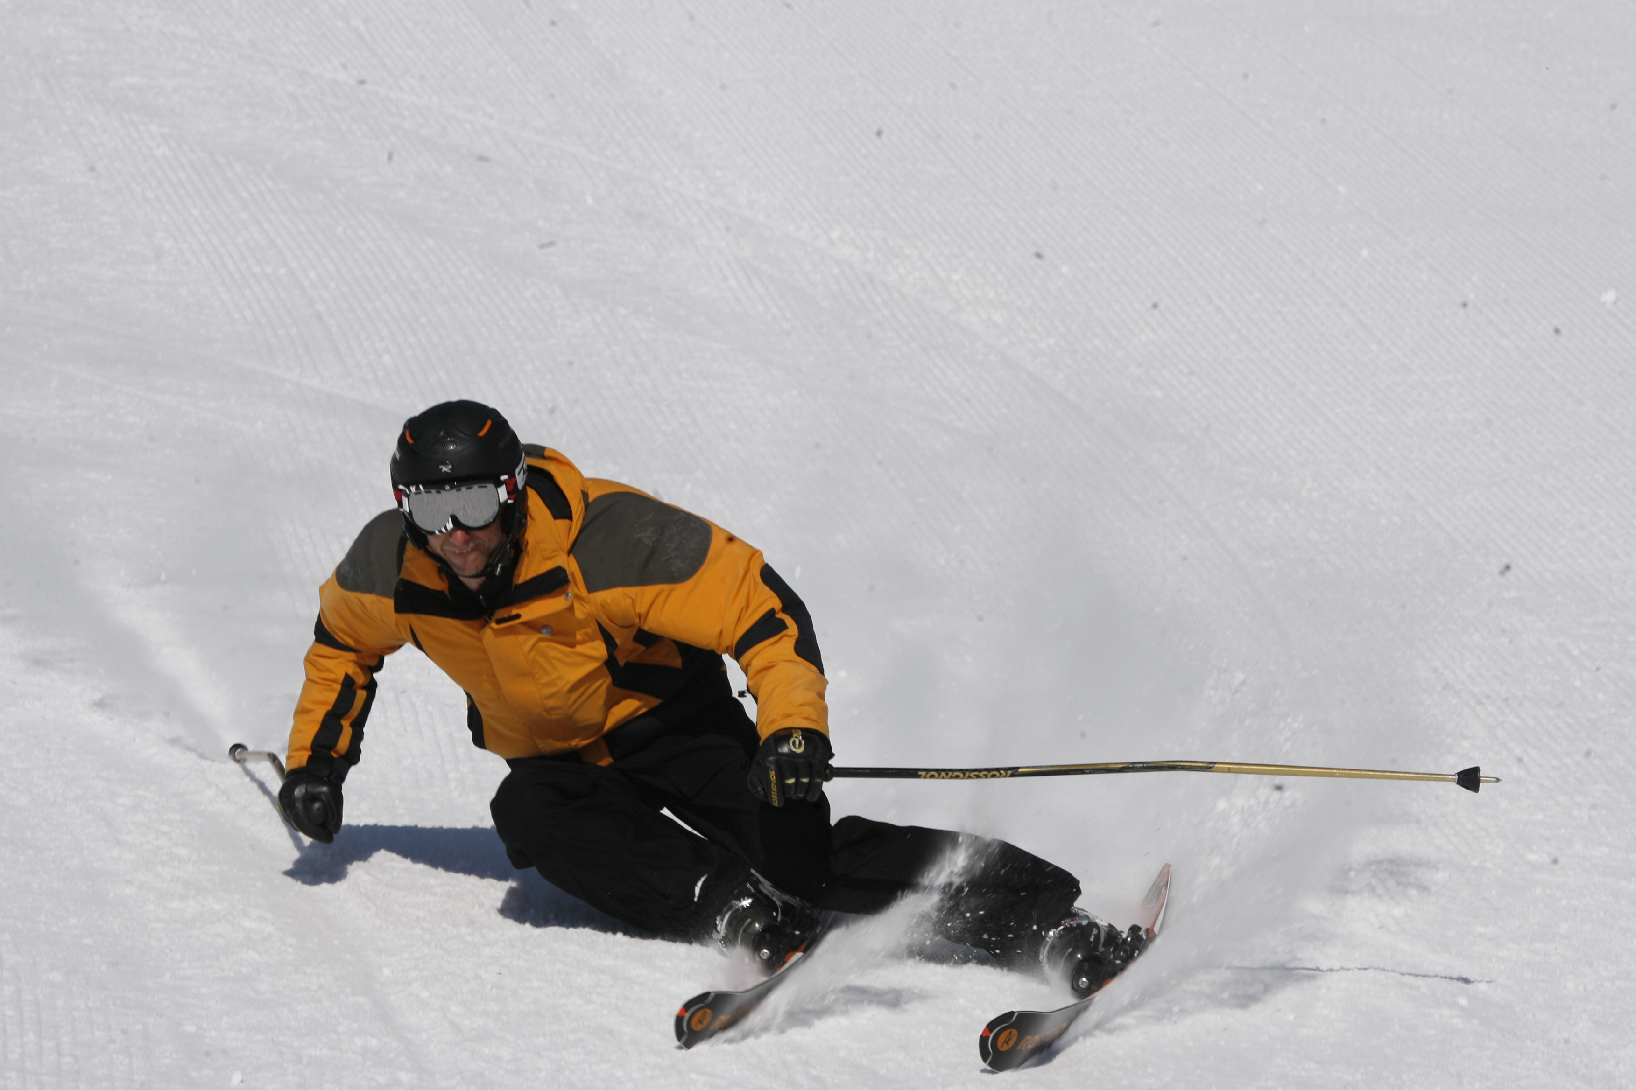
Spotlight
Ian Hunter: Working in a winter wonderland
Ski retail, sales agency, represent multiple brands
Manufacturers to re-think their approach to ski
New technology drives sales in ski equipment
Snow sports and related equipment
Core business: alpine, Nordic and snowboard hard goods

Slide 4
Winter sport activities
Heli-skiing
“Snowcat skiing”: large, truck­like vehicles
Cross-country skiing
Snowshoeing

Slide 5
Distribution of skiers and snowboarders by region of origin
Source: Vanat, 2015, p. 16

Slide 6
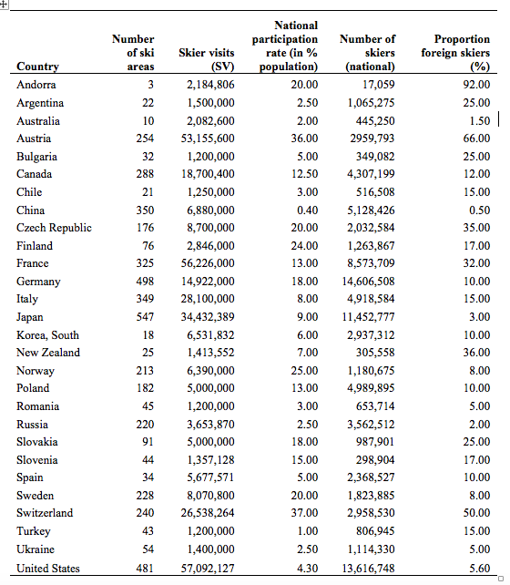
Skiers visits along with participation rates as a percentage of the population
Adapted from Vanat, 2014

Slide 7
The diversification of winter sport activities
Traditional winter sports activities | Contemporary winter sports activities
Skiing | Snowboarding
Cross-country skiing | Snowmobiling
Telemarking | Snowshoeing
Cat-skiing | Heli-skiing
Ice skating | Dog sledging
Horse-drawn sleigh | Tubing
Curling | Snowcycling/ Fat biking
Toboganning | Ice-climbing
 | Ice-driving
 | Ice sculpting
 | Snowskating

Slide 8
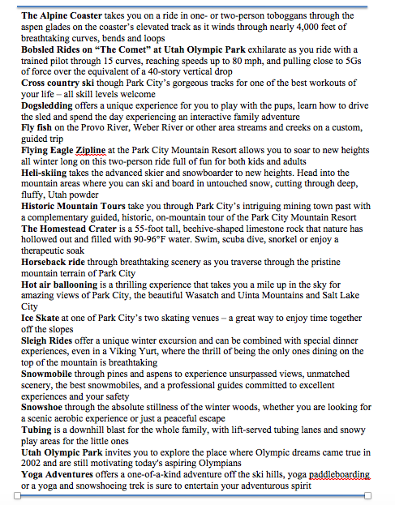
Winter sport activities at Washington School House in Park City, Utah
Source: Washingtonschoolhouse.com

Slide 9
Winter sport resorts
Ski resorts
  national resorts, regional resorts, top-class international destination resorts
Products and services
  skiing facilities, accommodation, food and beverages, ski schools, and equipment rental and merchandise
Strategies to enhance service experience
  product diversification, product improvement, or product differentiation

Slide 10
Skier visits worldwide
Source: Vanat, 2015, p. 15

Slide 11
Ski resort products and services
Source: Adapted from IBISWorld.com, 2013

Slide 12
Major markets for ski resorts
Source: Adapted from IBISWorld.com, 2013

Slide 13
Major players in winter sport tourism
Source: IBISWorld.com, 2013, p. 25

Slide 14
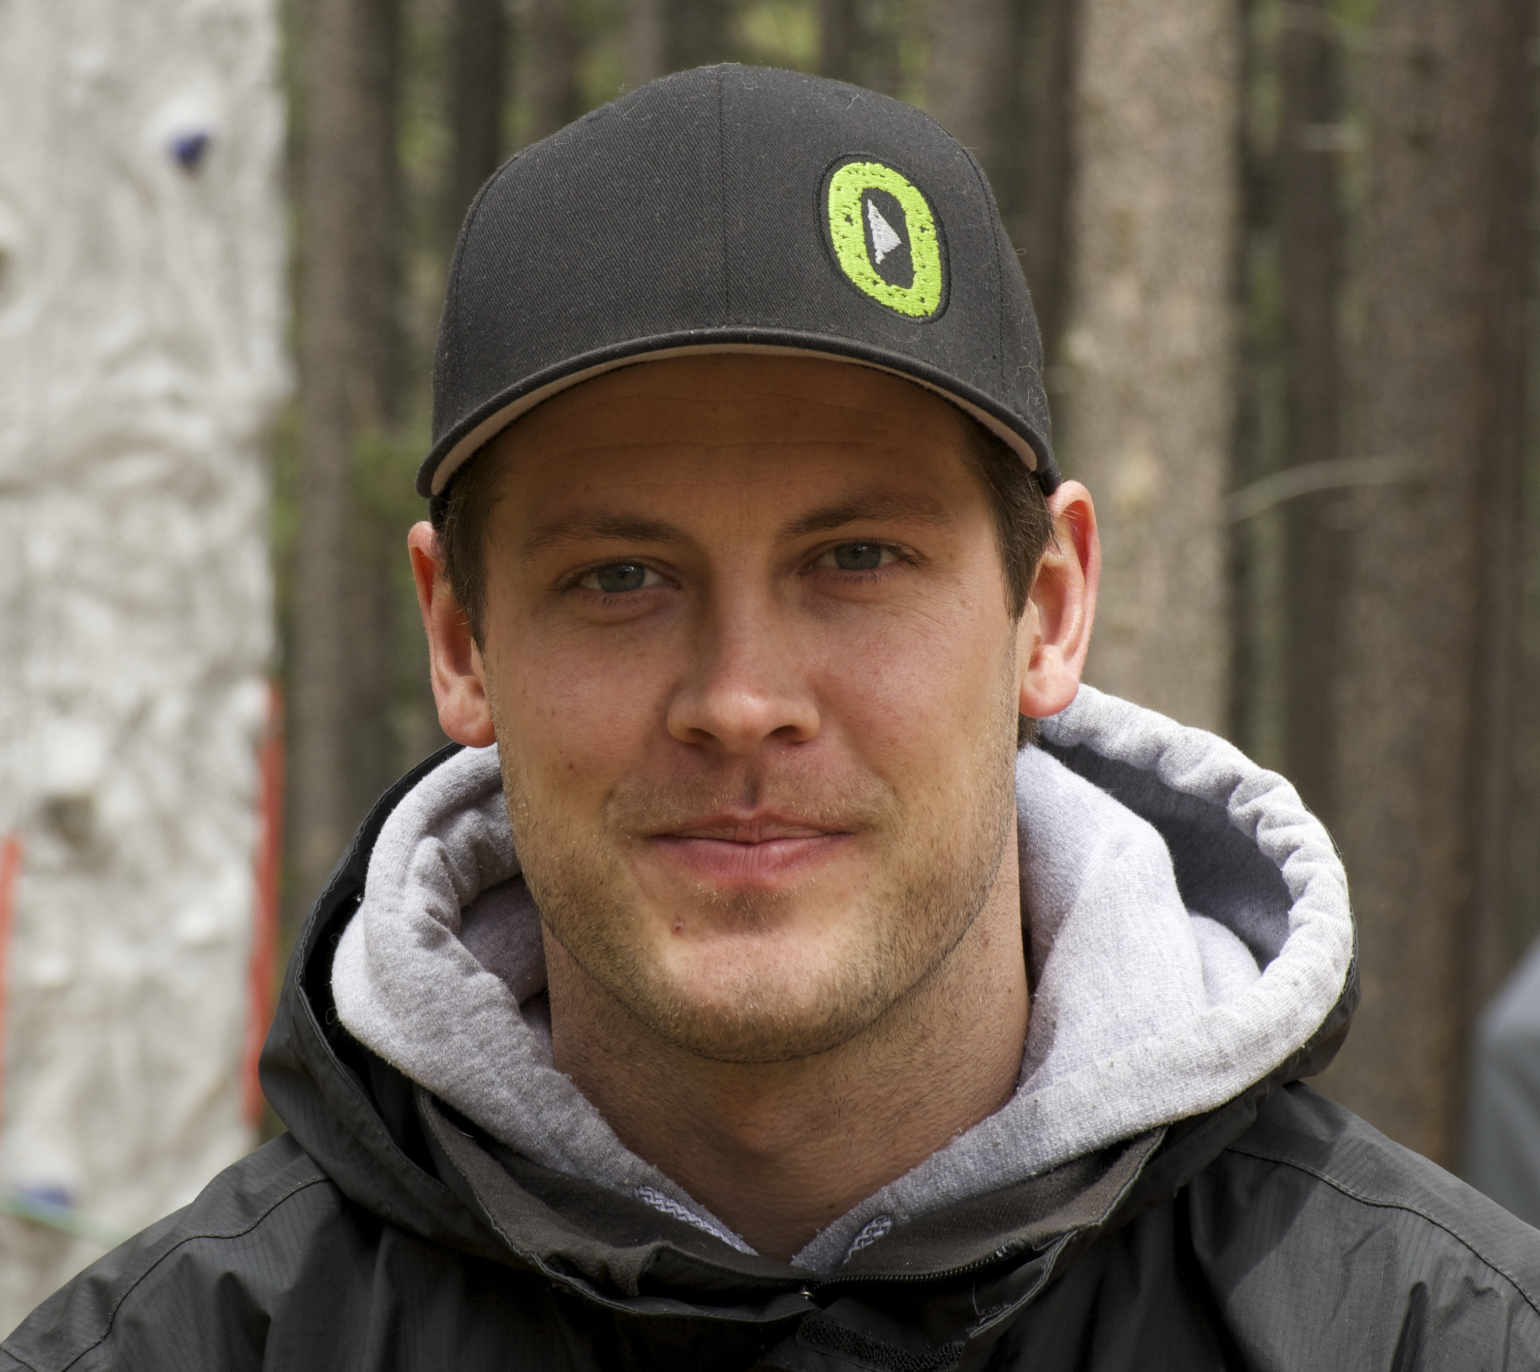
Profile: The wonders of winter zip-lining
A view of immense whiteness of a winter wonderland
Provides all-season business
Wide appeal: “storytelling factor ”; social aspect
Vary from resort to resort
Is zip lining here to say?

Slide 15
Indoor ski resorts
Indoor plastic slopes or dry slopes
Best artificial slopes: simulate mountain conditions
More in developing countries: Dubai, Brazil…
Construction: world’s largest indoor ski slope, Harbin, China

Slide 16
Clothing and equipment
Clothing
  warm and fashionable
  gloves, baselayers, headwear, and neck gaiters
Equipment: snowboarding, action cameras, wearable technology

Slide 17
Alpine Ski Equipment Unit Sales in All Snow Sports Shops:
2010/2011 - 2013/2014

Slide 18
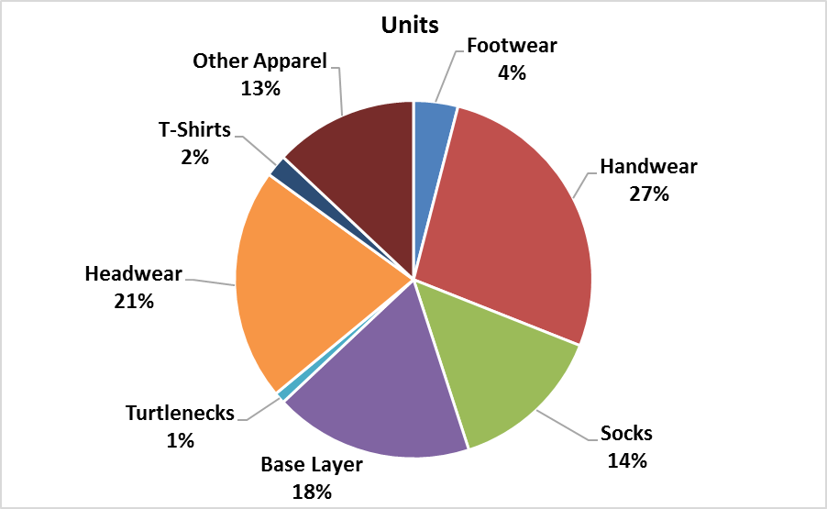
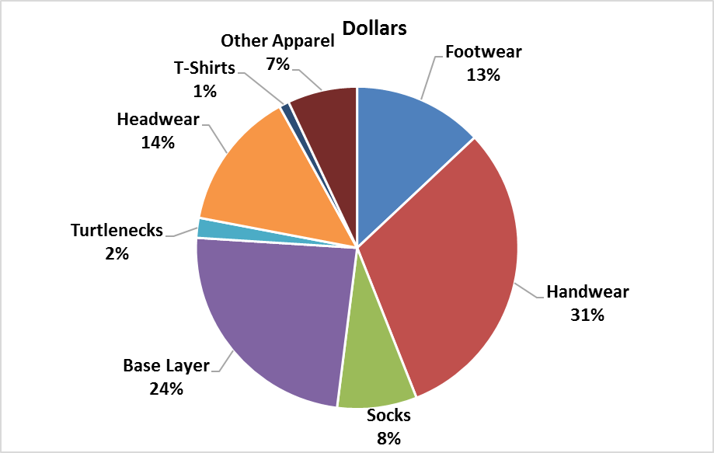
Apparel accessories sales in the U.S. 2013-14

Slide 19
Backcountry Equipment Specialty Inventory Units:
2010/2011- 2013/2014

Slide 20
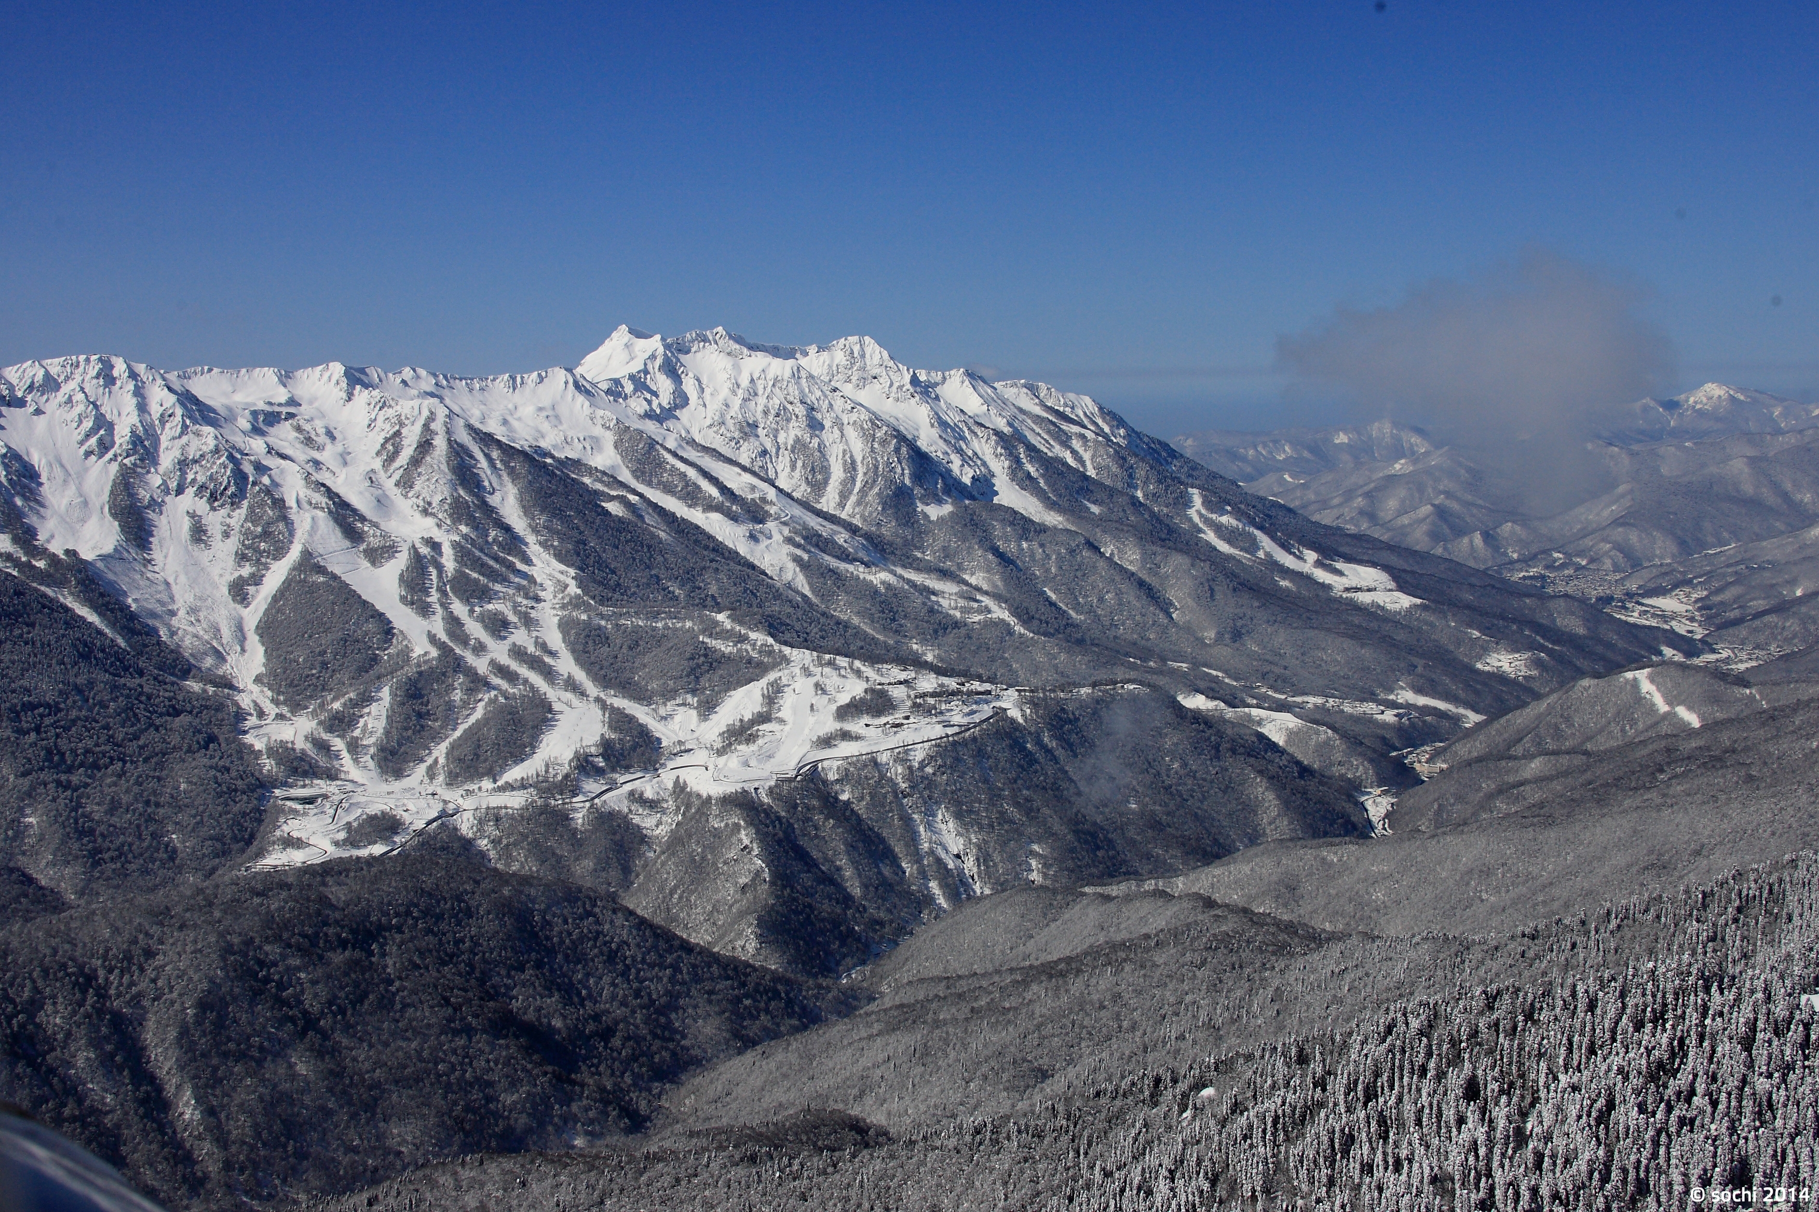
Case Study
The difficult birth of an all-season destination: Sochi, Russia
An all-year around destination
Host of the 2014 Winter Olympic Games
  Many setbacks
  Questions over legacy
  But Sochi now has good infrastructure
  Also put Russia on the map as winter sport destination

